Slide 1

Smart and versatile automatic billiard cue
28-03-2024
Paweł Dragon -1812238
Lucas van der Doelen-Kawazuti -1779168
Maëlle Perrier - 1794078
Tijn Verhees - 1756753
Tobias Wejbora - 1785486
4CC10
Notes:
Give a proper introduction, where you welcome everyone and introduce ourselves.

Slide 2
Content:
1 - Use cases and RPCs
2 - Functional breakdown
3 - Conceptual design
4 - Decision table
5 - Mechanical architecture
6 - System overview
7 - Key specifications - Test plan
8 - Accuracy budget
9 - Linear actuator design
10 - Control architecture
11 - Electrical architecture
12 - Power budget
13- Risk analysis

Slide 3
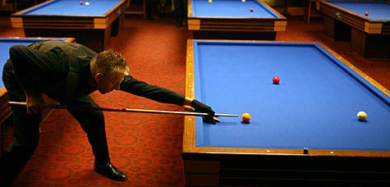
Use case:
Artificial opponent for training:
Replace a player when no one is around. The device should be able to act as a substitute player and perform varied shots.
A user can play against the device to improve their skills. This means the system should be mimicking the shots of high-performance players to challenge the user. The ability to make spin, reverse and pique shots is crucial.

Slide 4
User requirements
Long battery life (enough for one game)
High shooting power
Simple to use and light enough to carry
Compact to not obstruct the game
Versatile shot capability
Accurate
Easy to use

Slide 5
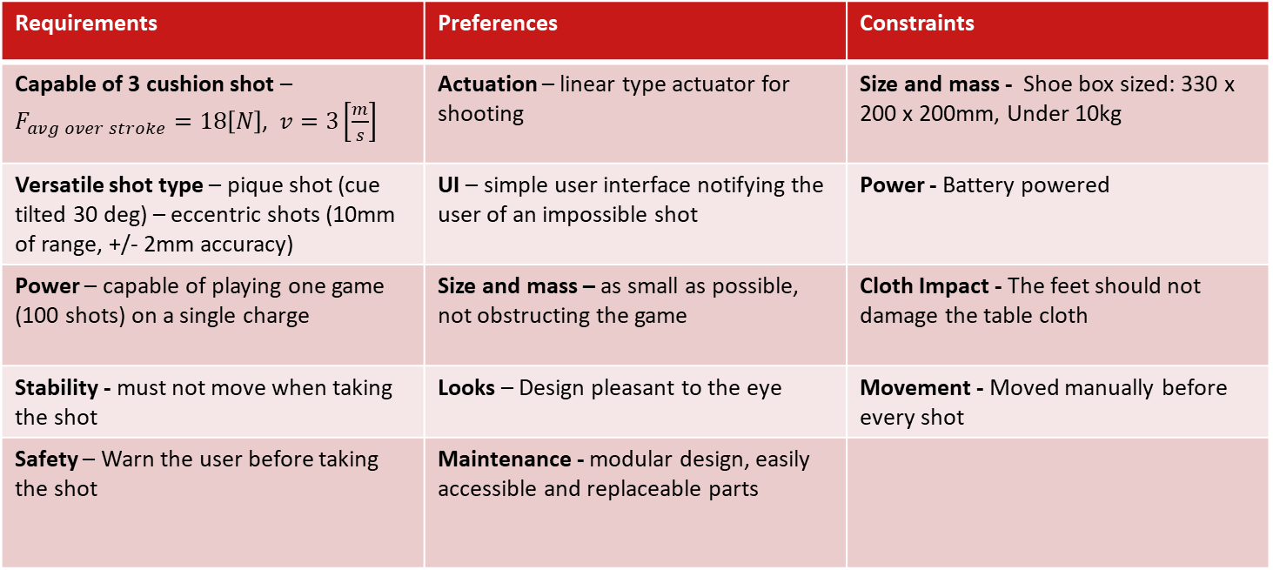
RPC list
Requirements | Preferences | Constraints
 | Actuation – linear type actuator for shooting | Size and mass - Shoe box sized: 330 x 200 x 200mm, Under 10kg
Versatile shot type – pique shot (cue tilted 30 deg) – eccentric shots (10mm of range, +/- 2mm accuracy) | UI – simple user interface notifying the user of an impossible shot | Power - Battery powered
Power – capable of playing one game (100 shots) on a single charge | Size and mass – as small as possible, not obstructing the game | Cloth Impact - The feet should not damage the table cloth
Stability - must not move when taking the shot | Looks – Design pleasant to the eye | Movement - Moved manually before every shot
Safety – Warn the user before taking the shot | Maintenance - modular design, easily accessible and replaceable parts

Slide 6
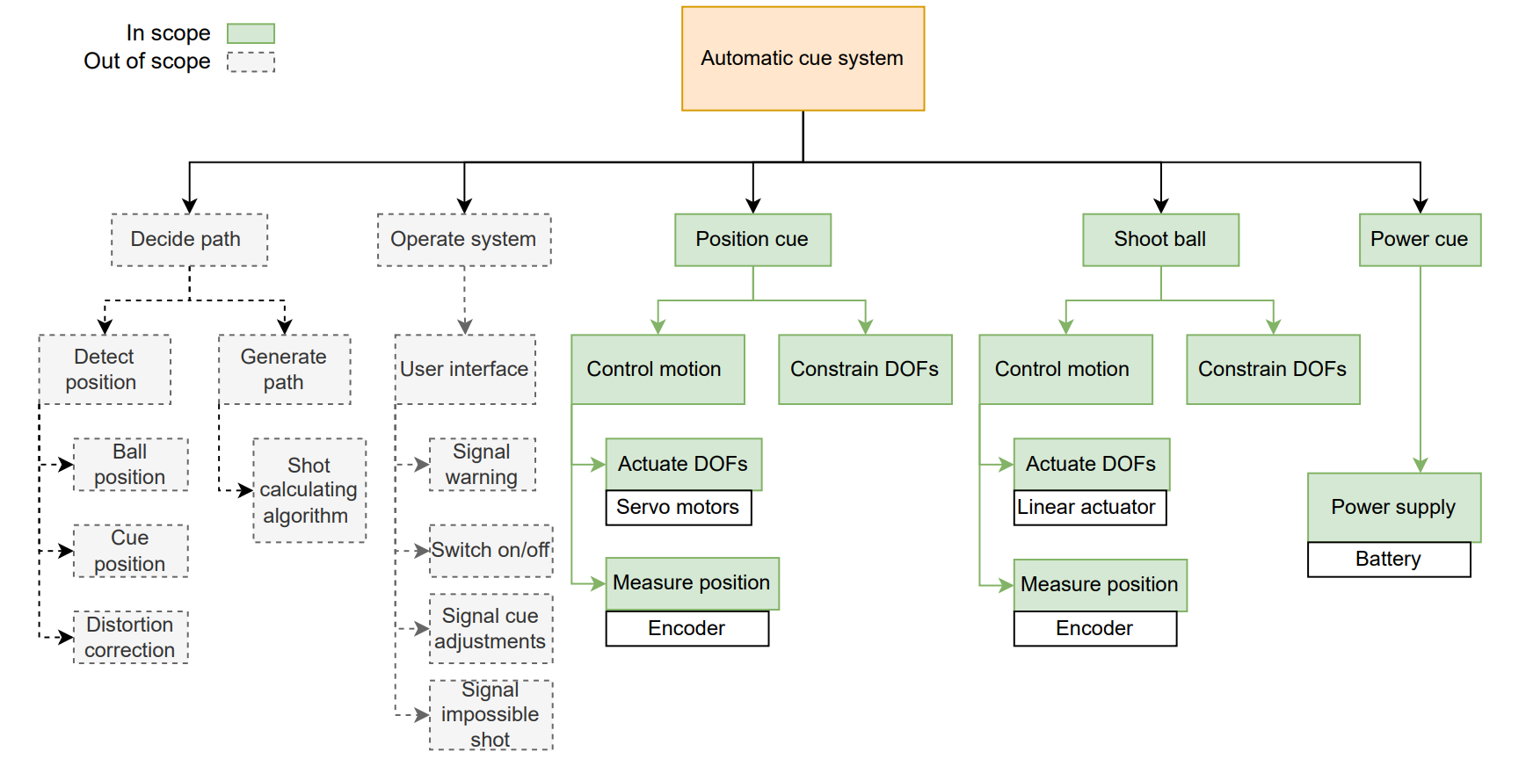
Functional breakdown

Slide 7
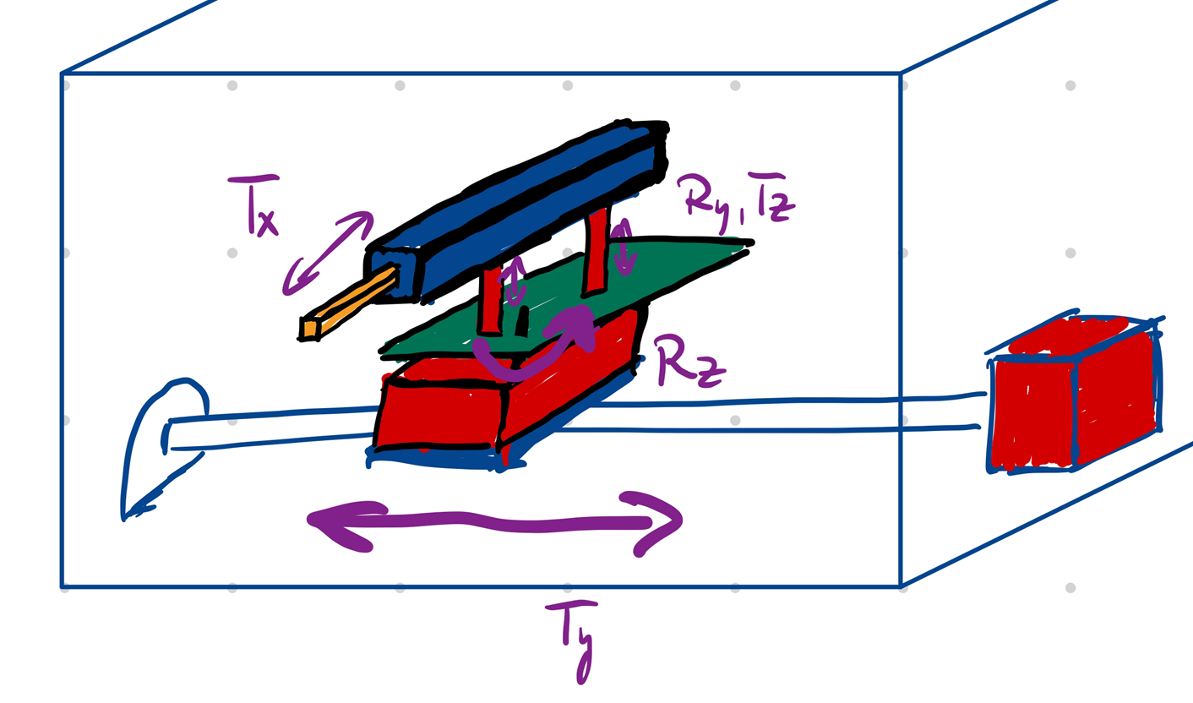
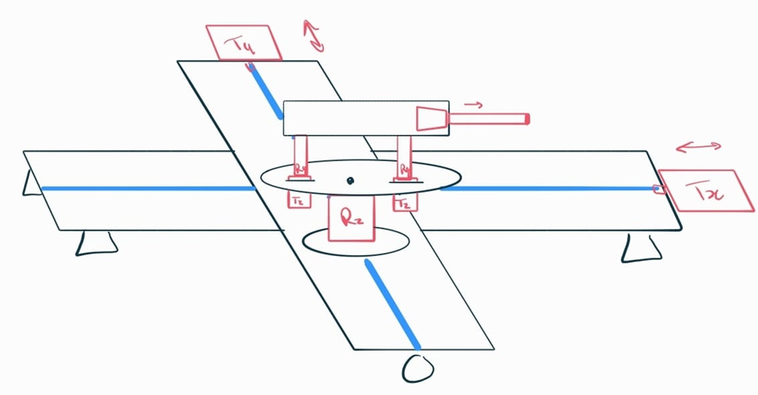
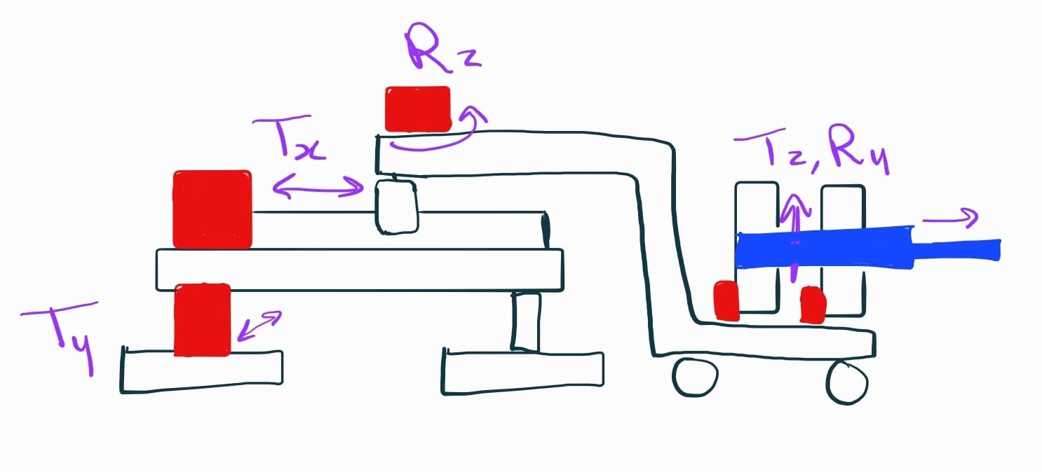
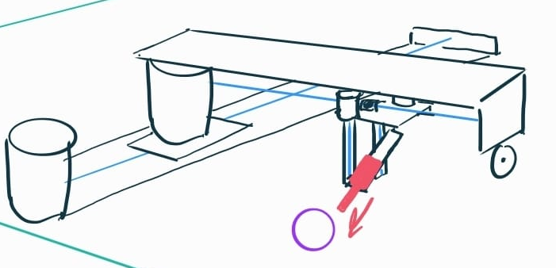
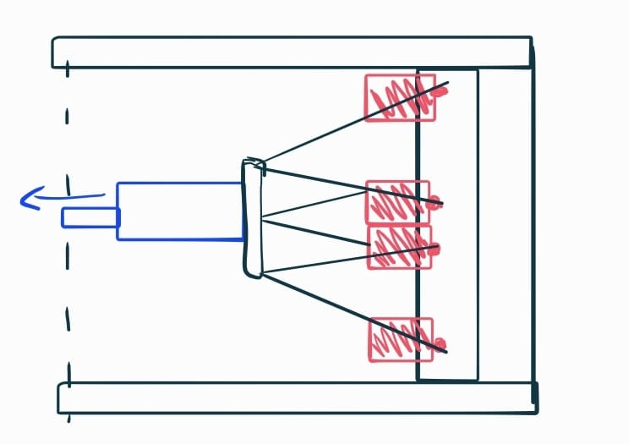
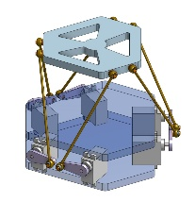
Conceptual designs
Design A: linear actuator also doing Tx motion
Design B: linear actuator decoupled from Tx motion
Design C: cart on wheels to limit height
Design D:
up-side down lead screw to limit height
Design E:
Stewart platform

Slide 8
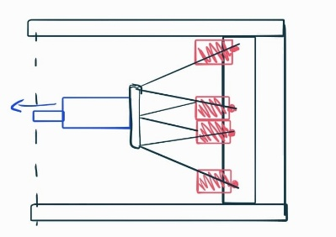
Decision table
A
Criteria | Importance | A | B | C | D | E
High shooting power | Must | - | + | + | + | +
High shot versatility ( spin, reverse and large angle) | Must | 0 | + | + | + | +
Low size | Must | - | - | 0 | 0 | +
High stability | Must | + | + | + | + | +
Low mass | Should | - | - | - | - | +
Separate motor each DOFs | Could | - | - | - | - | -
Pleasant looks | Could | - | - | - | 0 | +
 | Rank | 5 | 4 | 3 | 2 | 1
B
C
D
E

Slide 9
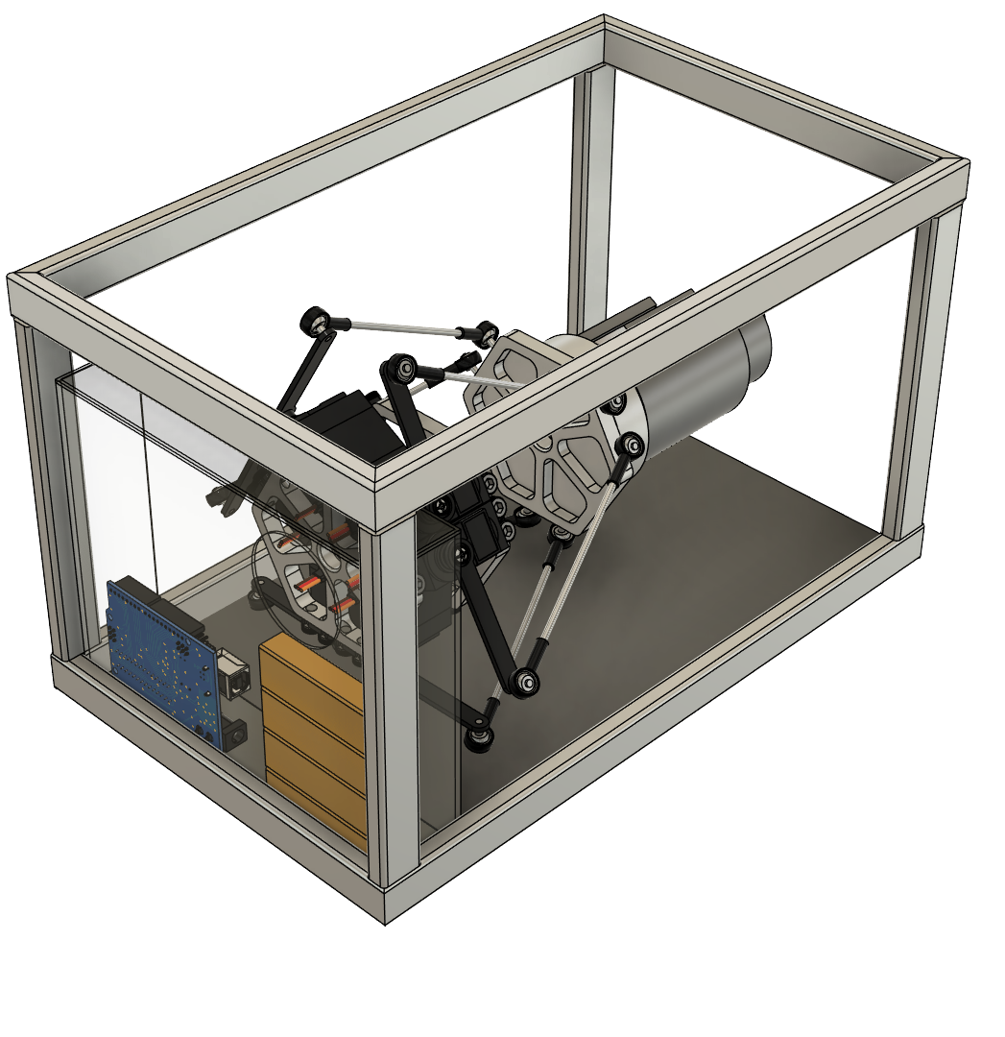
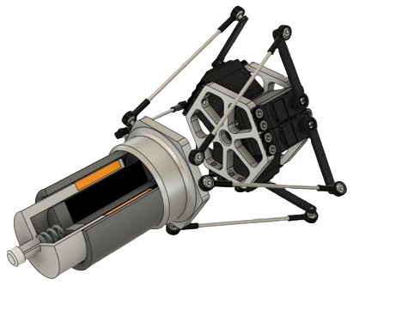
Developed concept (Mechanical Architecture)
6 high torque servos connected to 3mm steel rods
Aluminium platform and servo mounts
Rod end bearings connecting the platforms
Steel 50mm servo crank arms
Aluminium 300 x 220 x 220mm frame made from rectangular 20 x 10 x 2mm profiles
Neutral platform height – 115 mm
Acrylic box for electronics

Slide 10
Mass Budget and specifications
Specifications
Motion in 6 degrees of freedom
Range of motion +/- 30mm in all translations
Platform pitch and roll: 30 degrees
Fits in the 330 x 200 x 200mm box
6 high torque servos steering the platform
Part | Mass
Frame | 2.7kg
Stewart Platform | 2.1kg
Linear actuator | 1.6kg
Electronics and box | 1.5kg
Total | 7.9kg

Slide 11
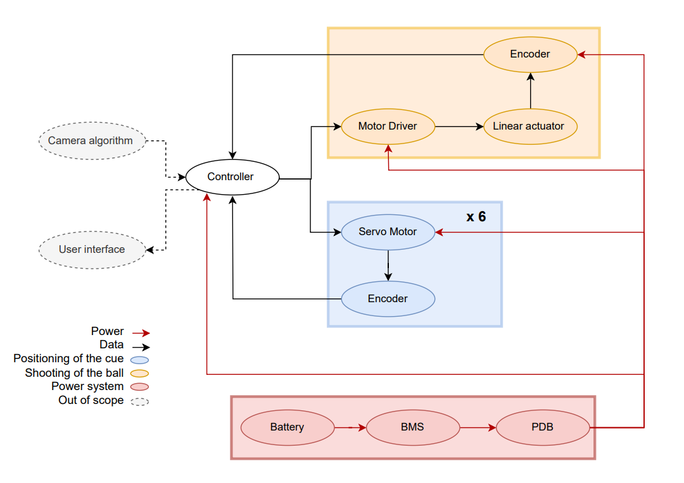
System overview
Functions:
Positioning the cue
Shoot the ball
Interfaces:
Power
Data
Boundaries:
Not include camera recognition and path-deciding algorithm
Not including user interface

Slide 12
Key specifications- test plan
Servo motors
Holding torque – Test by attaching weights to crank arm.
Voltage – tested by tracking voltage during displacements.
Angle = 0-180[Degrees] tested by signaling the servo to move to limits, track with an angle guage.
Linear actuator
Peak force = 39.82[N] - test with a load cell
Stroke = 50mm - test with incremental encoder
Current = 15[A] - test with a current sensor
Encoders
Pulses signal - Test output signals with an oscilloscope, count pulses for a full rotation
(check if stable and free of noise)
Battery
Voltage = 24[V], Current =10[A] - Test the BMS
Load test - Check temperature changes and power output.
Battery life - record number of 3 cushion shots taken with full battery.
Arduino Uno
Input/Output voltage = 5[V] Test
with multimeter.
Data reception - Test by using serial monitoring
Load testing - Run full test setup, while tracking power usage and temperature fluctuations
Motor driver
Current – test with a multimeter
Voltage – test with a multimeter
Heat – check it does not overheat with thermal camera

Slide 13
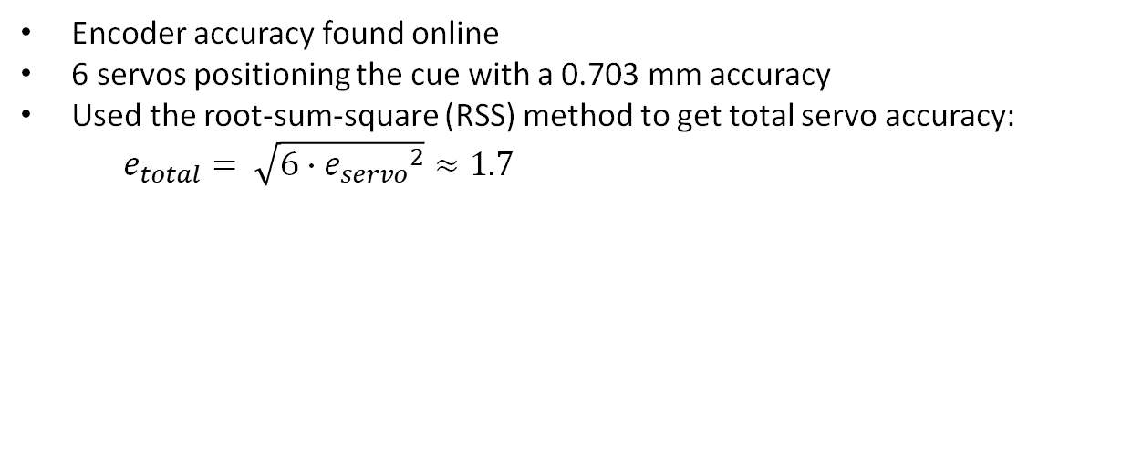
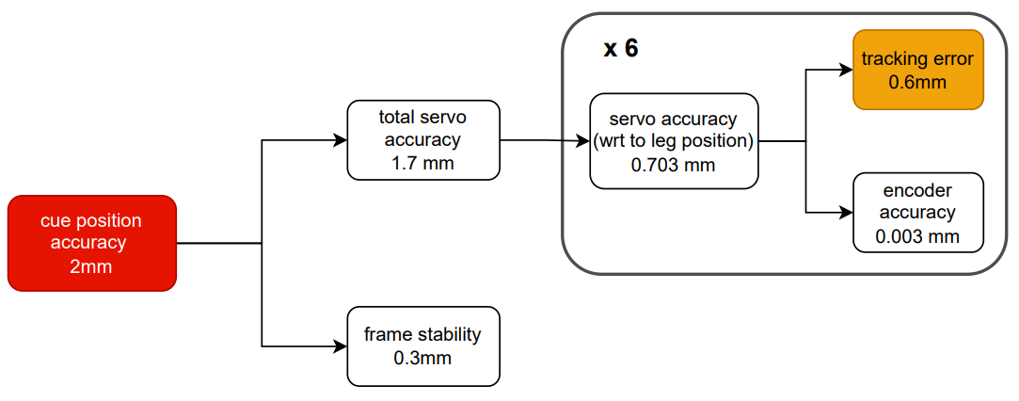
Accuracy budget
Need a tracking error of 0.6mm maximum to meet 2mm accuracy requirement

Slide 14
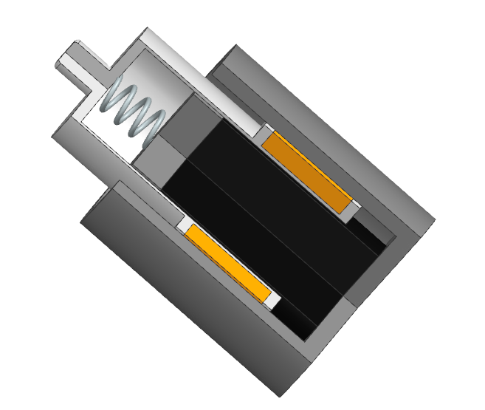
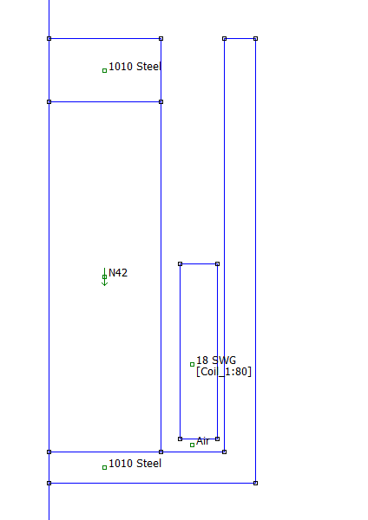


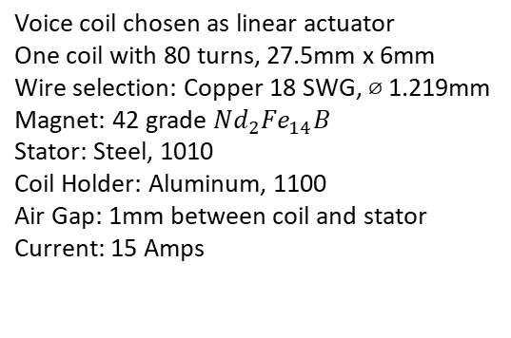

Electromagnetic linear actuator
Coil holder
Section View
17.5mm
5mm
Fast shot: 1.9-3.2 m/s
Power shot: 3.2-4.5 m/s
Average force required over a 50mm stroke
https://drdavepoolinfo.com/faq/speed/typical/
10mm
Target Requirements:
Return Spring
55mm
Copper Coil
Permanent magnet
Steel Stator
5mm
32.5mm
https://www.copperbraid.co.uk/current-ratings/

Slide 15
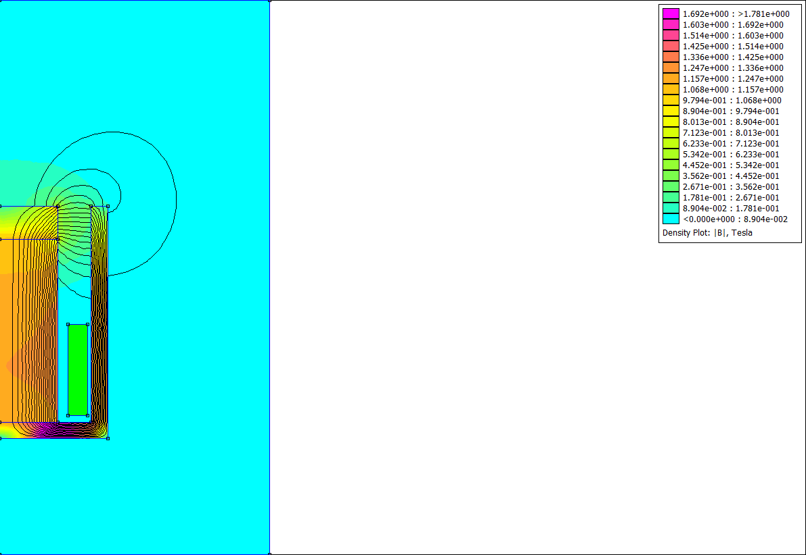
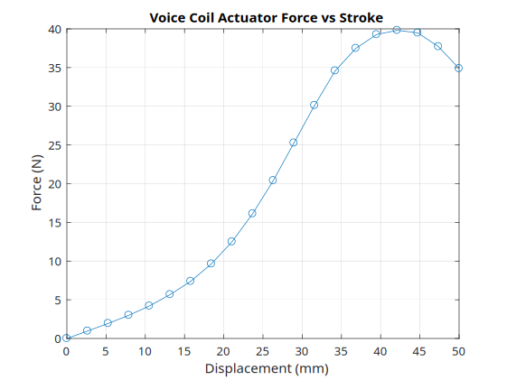
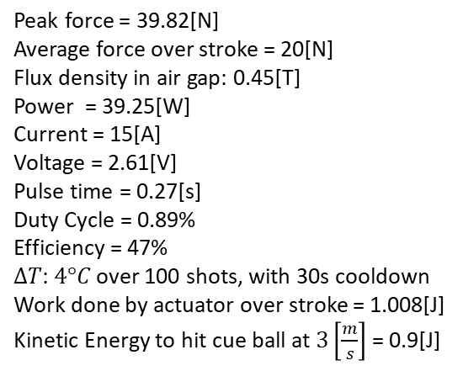
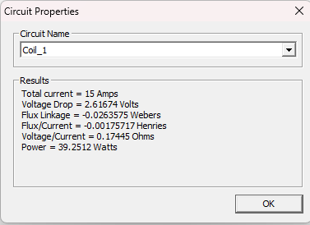
Electromagnetic linear actuator
Flux leakage from high reluctance air gap
Steel Stator: Low reluctance, high permeability return path

Slide 16
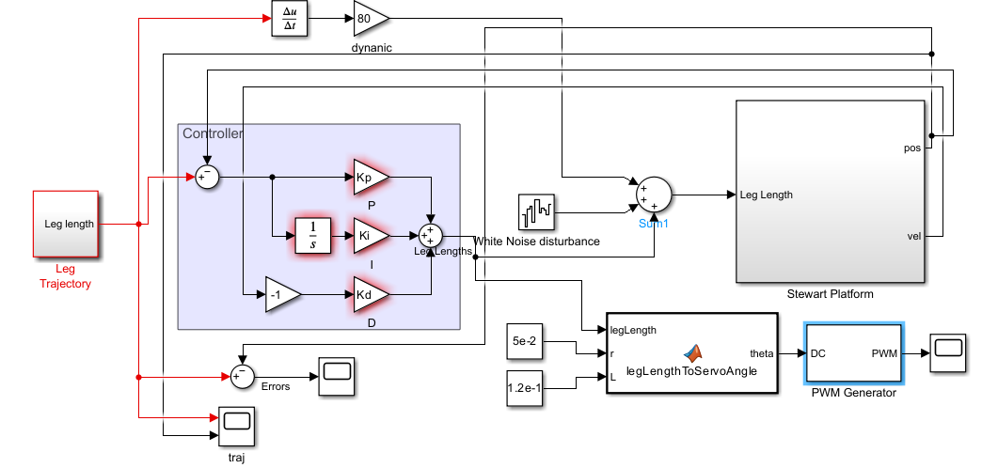
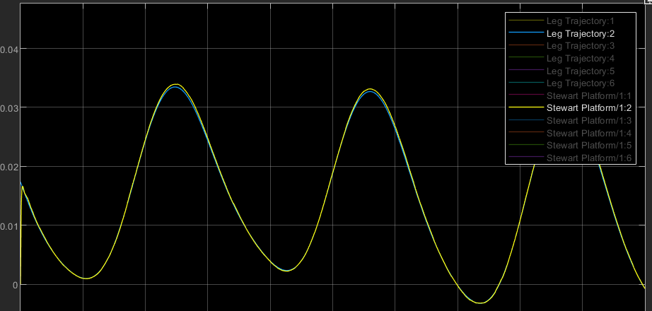
Control architecture
Modelled with PID controller and feedforward
Input: 0.1m amplitude sine waves
Added disturbances with white noise
Max error: 0.57mm
➔ Good reference tracking and disturbance rejection
https://nl.mathworks.com/help/sm/ug/stewart-platform.html
Error< 0.6mm so meets the accuracy requirements

Slide 17
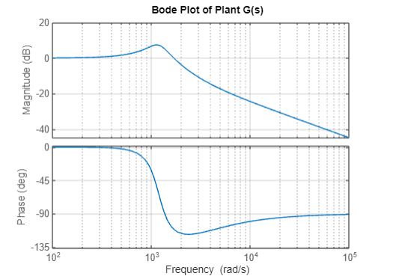
Control architecture
Modelled plant as mass-spring-damper system for simplicity
Phase margin: 68.8 degrees
Stable behaviour since margins are sufficient

Slide 18
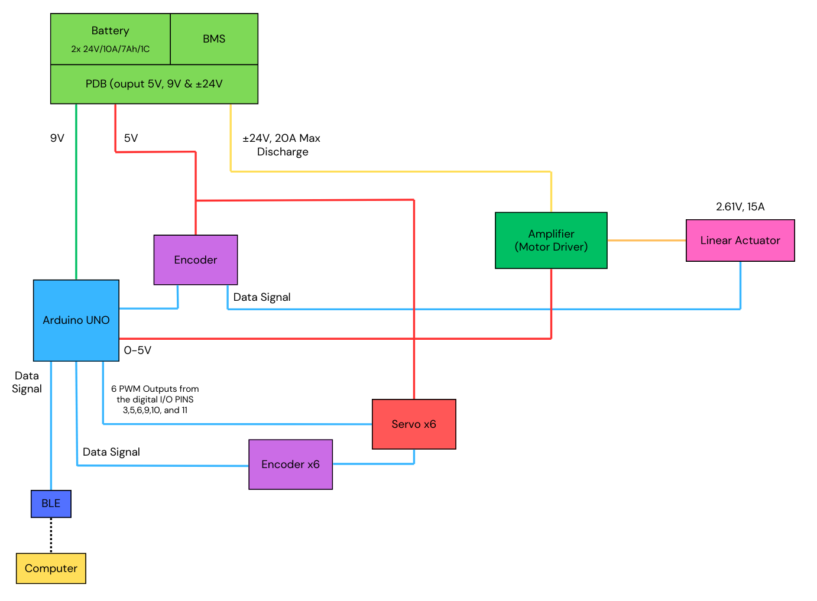
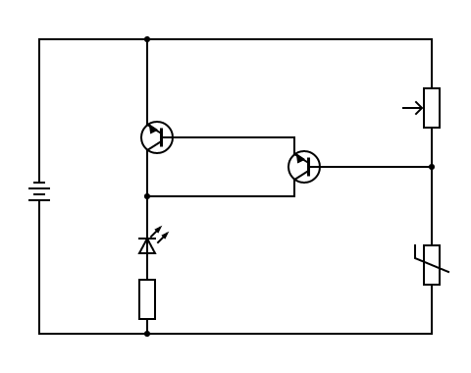
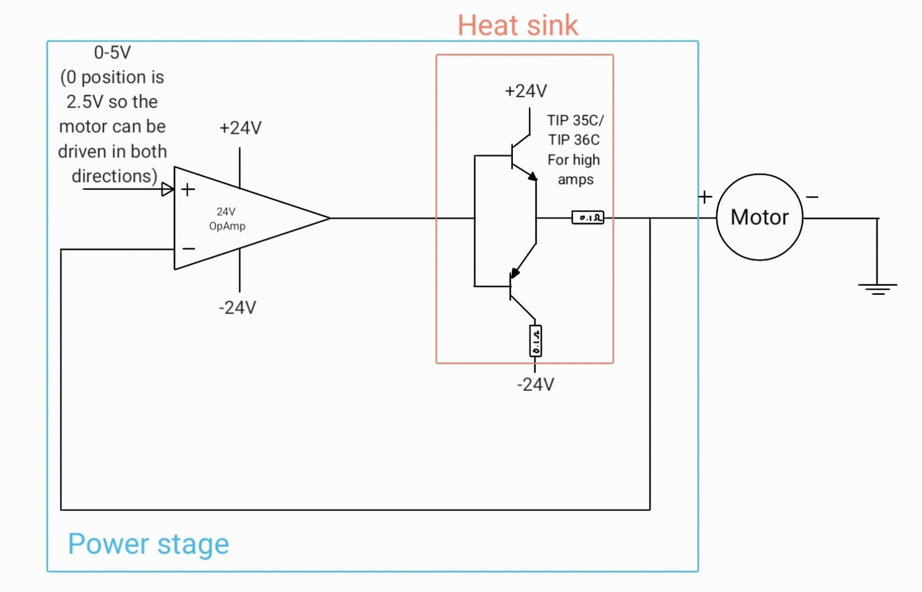
Electrical architecture
Overheating sensing circuit (warning light when amp transistors overheat)
Overall Electrical Architecture
Linear Amplifier for motor driver

Slide 19
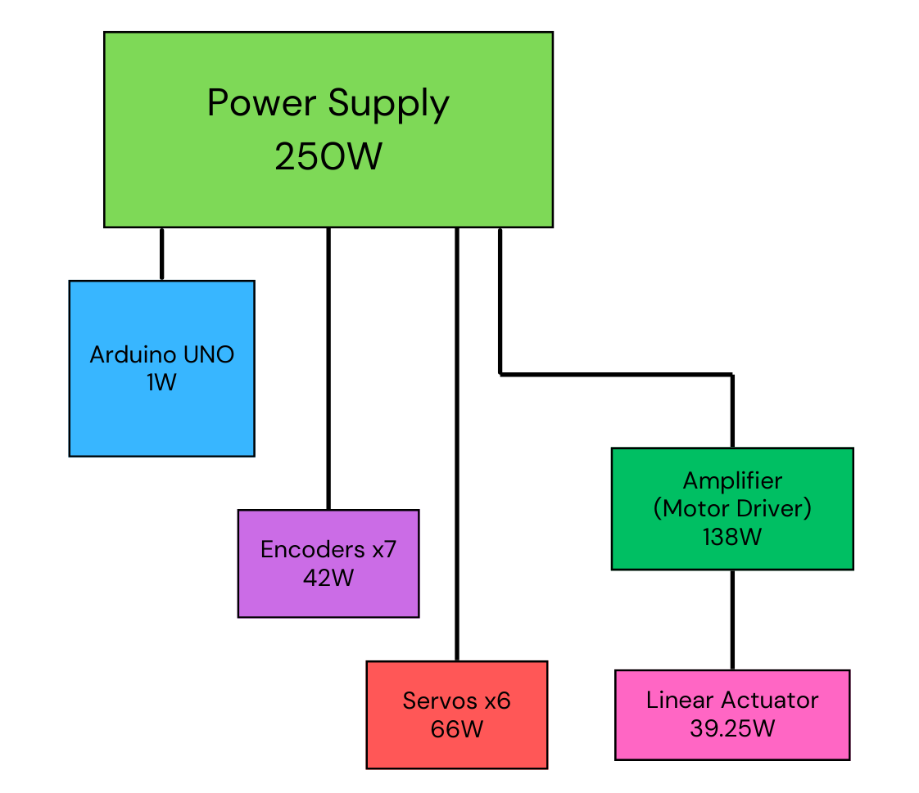
Power budget
Total load from the circuit estimating some buffer for losses in wires etc. is 250W
Averaging the power consumption with a cutoff voltage of 21V for Li-Po protection gives a mean 11.1A
Given the battery capacity of a combined 14Ah the total run-time of ≈ 60 mins or 1hr
Therefore, can last a full game as required

Slide 20
Risk analysis
Scores: from 1 to 5 (1 negligible, 5 severe)
Possible risks | Impact | Likelihood | Detectability | Total | Contingency
Rod failure | 5 | 2 | 3 | 30 | Use stronger materials, FEM testing
Servo breaks | 5 | 3 | 4 | 60 | Use high-quality servos add spare replacement servos, software monitoring
Battery failure | 5 | 1 | 5 | 25 | Battery management system,
Battery depletion | 5 | 2 | 4 | 40 | battery charge monitor
Linear actuator gets stuck | 4 | 2 | 2 | 16 | Add end stops/limit switches
Sensor fail | 3 | 3 | 2 | 18 | Sensor redundancy or fallback logic
Overheating (coils & motor) | 5 | 2 | 3 | 30 | Add temperature sensor, limit on duty-cycle
Incorrect alignment / calibration | 3 | 3 | 2 | 18 | Add software calibration, removable transportation restraints
Wire breakage or loose connection | 5 | 2 | 4 | 40 | Better soldering techniques, strain relief mechanisms on wires
Software defect | 4 | 3 | 3 | 36 | Simulation and testing, debug terminal

Slide 21
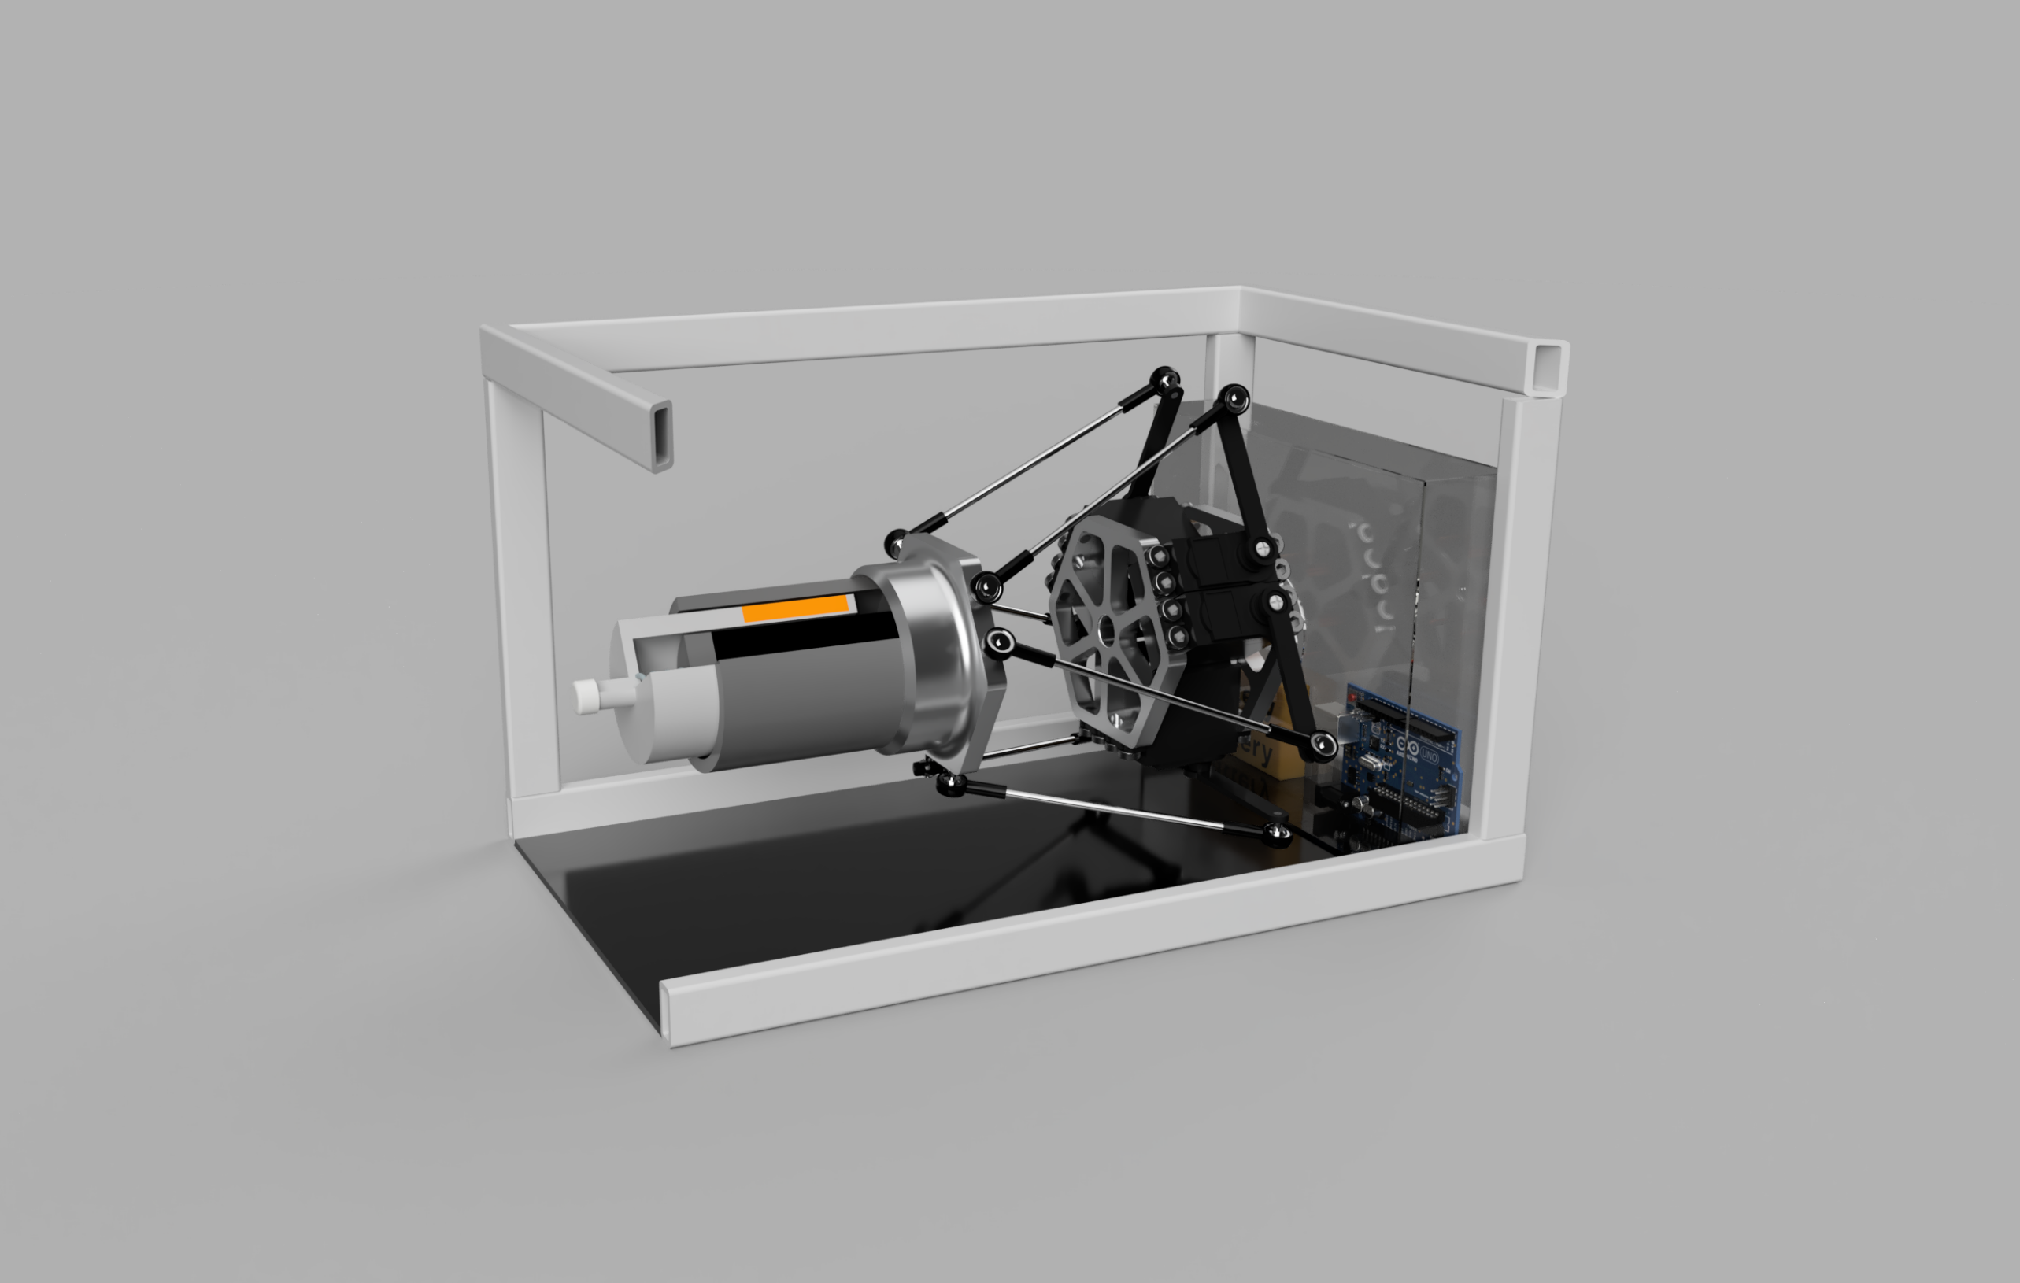
Questions?

Slide 22









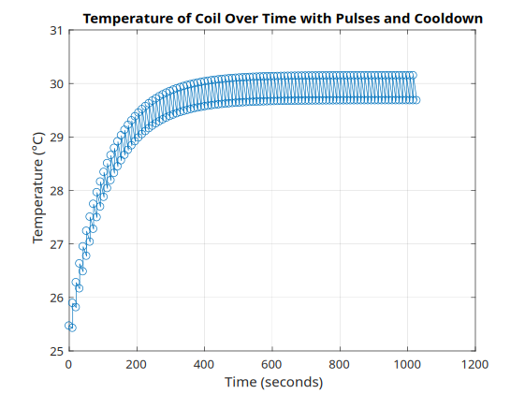
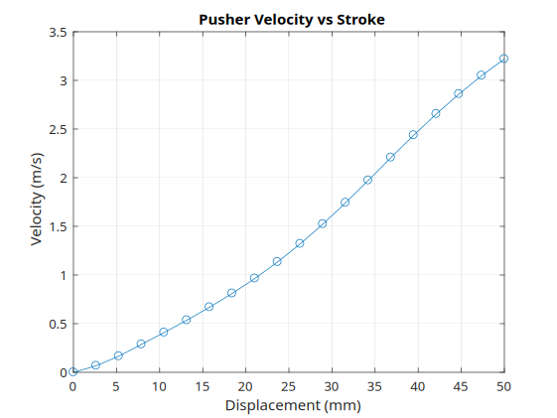
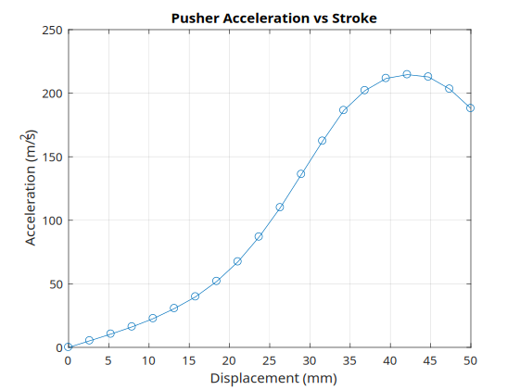


Linear actuator calculations
Inertial Matching
Constant force over the stroke

Slide 23
Power budget calculations
Power dissipation Arduino UNO source:
https://www.researchgate.net/figure/Measured-power-consumption-of-an-Arduino-UNO-R3-board-under-different-test-conditions_tbl2_327132935
Power dissipation Amp:
Transistor datasheet: https://www.farnell.com/datasheets/2309916.pdf
P_{amp} = P_{motor} + P_{transistor} +P_{resistor}
= (I_{mot} x V_{mot}) + 2(I_{trans} x V_{trans}) + 2(I_{res}² x R_{res})
= 39.25W + 54W + 45W
=138.25W
Power dissipation encoder source:
https://www.tinytronics.nl/en/switches/manual-switches/rotary-encoders/dfrobot-fermion-8421-encoder-horizontal
Power dissipation Servos:
P_{servos} = 6 x (V_{servo} x I_{servo})
= 6 x 5 x 2.2
= 6 x 11W
= 66W
Run-time:
V_{avg} = (24V+21V)/2 = 22.5V
I_{avg} = P/V_{avg} = 250W/2.25V
= 11.1A
Runtime = 14Ah/11.1A
= 60.002 mins
Power dissipation BT module source:
https://www.tinytronics.nl/en/communication-and-signals/wireless/bluetooth/modules/hm-10-c2541-bluetooth-4.0-module
Power dissipation Servo source:
https://www.tinytronics.nl/en/mechanics-and-actuators/motors/servomotors/mg996r-servo-10kg-continuous
Note the temperature sensing circuit for the linear amplifier is not part of the main architecture, but will draw power from the PDB. The thermistor on the heatsinks of the transistors will make a working LED turn on if it reaches above a certain critical threshold of 90°, a 40% safety margin below the max temp.

Slide 24
Argumentation for decision table (Must)
Criteria | Argumentation for each sign (-/0/+)
High shooting power | A uses the same linear actuator to shoot the ball and to translate in x. This combination of functions will impact its shooting power. All the other designs have a specific linear actuator to shoot the ball, independent of the other motions.
High shot versatility ( spin, reverse and large angle) | For the same function combination issue, design A will not be able to accurately place the cue in the x direction (close to the ball) to make the accurate shots (spin and reverse). The rests of the designs do not face that problem.
Low size | Design A and B are large in height since lead screws and rotational motor (Rz) are stacked under the linear actuator. This makes the actuator too high to reach the ball on the table. Design C and D are quite large and might not fit in the limited size because they use lead screws for translations. E is very compact and can be dimensioned to fit the requirements.
High stability | All the designs have a stable 4 or more feet with some type of velcro or rubber at the bottom.

Slide 25
Argumentation for decision table (Should/could)
Criteria | Argumentation for each sign (-/0/+)
Low mass | Following the same logic as the low size requirement, only design E is meeting this low mass requirement since it is only composed of 2 platforms and 6 rods. It is much easier to move around the table than the other bulky designs.
Separate motor each DOFs | None of the designs are completing this requirement. A,B,C, and D are using 2 lead screws to move and tilt vertically. Design E uses 6 motors to actuate all DOFs.
Pleasant looks | This is quite subjective, but design A, B and C are quite bulky and unappealing while D is similar to a 3D printer, which is already more pleasant to look at. E is much more compact and its complex mechanism makes it the most visually appealing design.

Slide 26
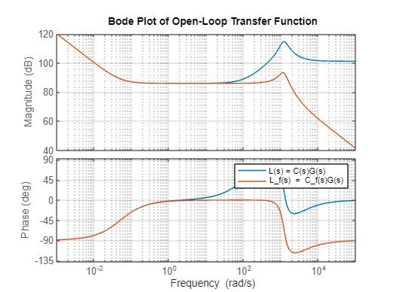

Appendix: Control architecture 1
Low-pass filter with cutoff frequency 100rad/s and to
get better noise attenuation
In graph: Orange line with Low-pass filter, blue without
Assumptions based on calculations and research:
K = 489715.96 N/m, m = 0.348 kg, d= 200 N*s/M
PID parameters for best tracking:
P = 20000 , I = 1000, D = 200
Controller transfer function:
Open-loop transfer function:

